Slide 1
Assoc. Prof. N. Ramakrishnan Room No. 38, Level 4, Building 2 ramakrishnan@monash.edu
ECE3073
Computer Systems
Lecture – 1, week 1 2022

Slide 2
Acknowledgement
The original slides were by A/P Andy Russell. Some modifications and additions by Horace Josh and Clive Maynard

Slide 3
ECE3073 Computer Systems L1 - Introduction
This group of slides provides:
• a general introduction to the unit,
• some administrative details which you can view in more detail in the unit guide, and
• a bit of background material regarding computer hardware and software architecture.
ECE3073 Computer Systems

Slide 4
ECE3073 Computer Systems
Details about the unit are given in the unit guide which you can access via Moodle.
There will be 2 hours of lectures and a 3 hour compulsory laboratory session each week (except for week 1)
It is expected that you will spend at least 7 hours each week preparing for the labs and studying the lecture material. You must complete preliminary work before the lab.
If you failed this unit previously, it is departmental policy that you must retake the whole of the unit including the laboratory component.
ECE3073 Computer Systems

Slide 5
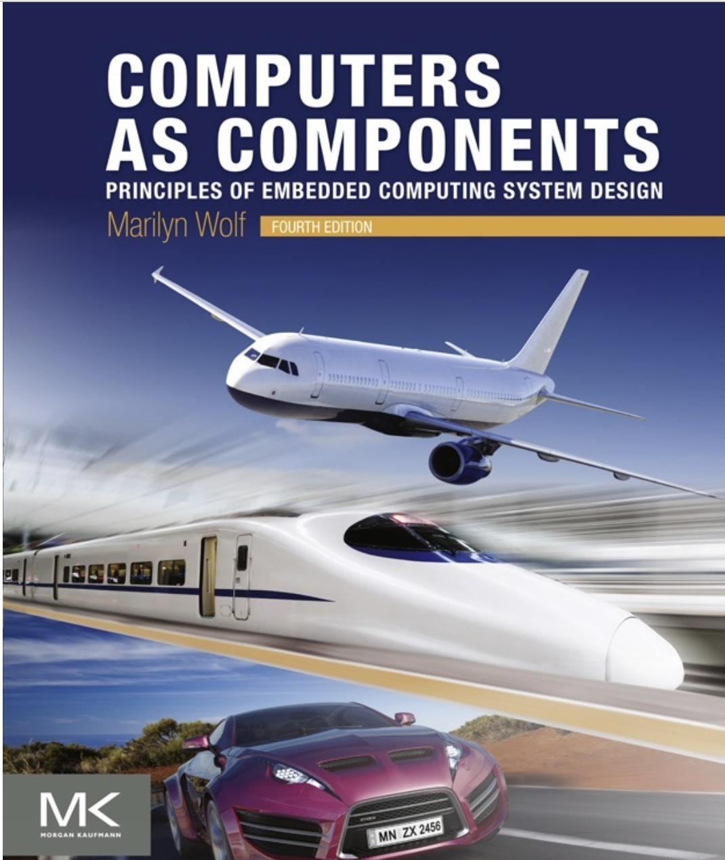
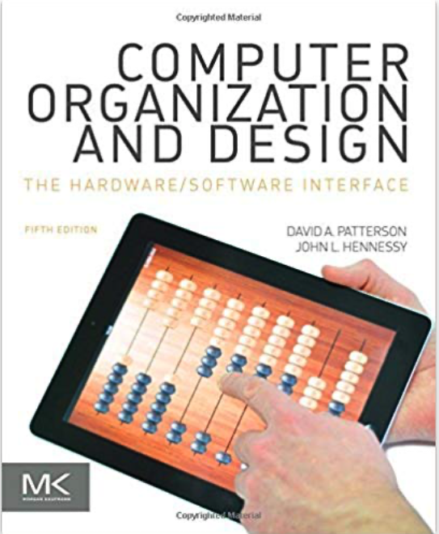
References:
A lot of the material covered in the lectures is explained further in these books:
Marilyn Wolf, Computers as Components:
Principles of Embedded
Computer System Design (4th Edition),
Morgan & Kaufmann
David A. Patterson and John, L. Hennessy, Computer
Organization and Design: The Hardware/Software Interface, (5th Edition)
Morgan & Kaufmann
These books represent a significant source of valuable information and will be referenced as part of the unit content.
There are also good online material which can help you progress.
ECE3073 Computer Systems

Slide 6
ECE3073 Laboratories
Labs for this unit will start in week 2
You must allocate yourself to a laboratory time-slot. Because of limited resources in terms of computers and demonstrators you cannot attend a lab slot which you are not allocated to.
ECE3073 Computer Systems

Slide 7
ECE3073 Computer Systems
ECE2071 Computer Organisation and Programming
ECE2072 Digital Systems
ECE3073 Computer Systems
ECE3092 Engineering Design
ECE4075 Real-time Embedded Systems
Other Elective Units
ECE3073 Computer Systems
Notes:
The unit summarises previous knowledge and significantly extends it providing a base for subsequent units. As my knowledge of the content of these units is limited to available documentation I may assume some knowledge which is not known and assume I need to cover aspects when they have been covered. I expect you to give me the appropriate feedback!!

Slide 8
What you should already know!
Digital electronics: logic gates, combinational and sequential circuits, flip-flops, counters, registers etc.,
C Programming: ability to write a small program using function calls, passing variables, pointers and return values
Basic electronics: Transistors, Operational amplifiers etc.,

Slide 9
What this unit covers
This unit covers a range of material which is EXTREMELY important for people involved in advanced applications of microprocessors and microcontrollers.
You have already learnt about C programming and also the hardware architecture of the MIPS processor (ECE2071 or equivalent).
You also should have a basic knowledge of Verilog from ECE2072.
Here you will build on this knowledge to learn about the software and hardware required for interfacing a microprocessor to the outside world.
A week-by-week breakdown of the material covered in this unit is available in Moodle.
BTW if you are not confident in your C programming and Verilog abilities then study the material in ‘ECE3073 Remedial Material’ available on Moodle.
ECE3073 Computer Systems
Notes:
I believe in getting the right balance of software and hardware in an embedded system …….”Al dente” as the pasta cooks state……..Not too hard, not too soft

Slide 10
What ECE3073 will mean to you
This unit encapsulates the main requirements to become a Computer Systems Engineer.
As such it covers:
Processors and Peripheral Hardware
Programming technologies
Realtime Operating Systems

Slide 11
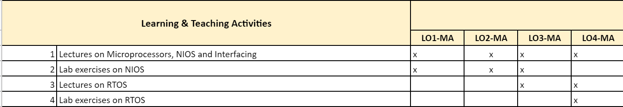
Unit Learning Outcomes
Describe the organisation, design and operation of an embedded (computer) system, microprocessor, the system bus, memory hierarchy, and peripherals
Design computer systems with a microprocessor/microcontroller and code suitable programs in C and/or assembly to process data from peripheral devices of the computer, and to further evaluate the performance of computer system design, and interpret the process of compiling high level language program.
Analyse different conversion techniques between analogue and digital signals, and different serial communication protocols.
Compare the performance of different real time schedulers and further design and assess real time software employing concurrency and inter-process communication.

Slide 12
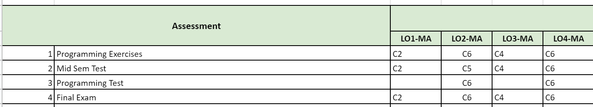
Contd..
Describe the organisation, design and operation of an embedded (computer) system, microprocessor, the system bus, memory hierarchy, and peripherals
Design computer systems with a microprocessor/microcontroller and code suitable programs in C and/or assembly to process data from peripheral devices of the computer, and to further evaluate the performance of computer system design, and interpret the process of compiling high level language program.
Analyse different conversion techniques between analogue and digital signals, and different serial communication protocols.
Compare the performance of different real time schedulers and further design and assess real time software employing concurrency and inter-process communication.

Slide 13

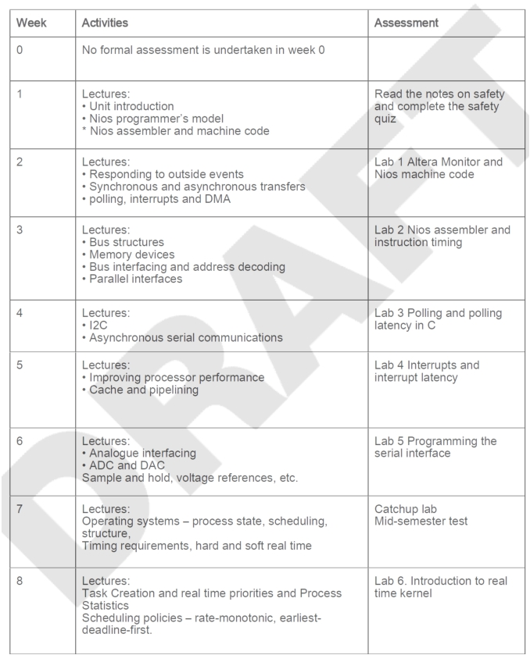
Unit Schedule
Notes:
To be modified!!!

Slide 14
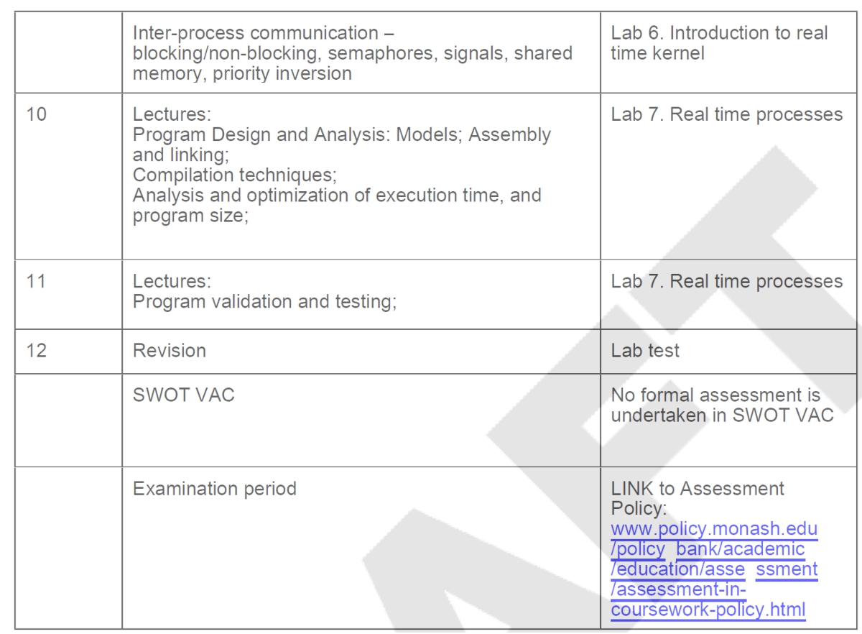
ECE3073 Computer
Systems
andy.russell@monash.edu
13

Slide 15
Assessment
Assessment Items | Weighting | Time
Labs | 15 % | every lab week
Lab Test | 15 % | Week-12
Mid Semester Test | 10 % | Week-7
Final Assessment | 60 % | During exam period
Hurdle: A minimum of 45% of the examination marks must be achieved.
All together you need to achieve a minimum of 50 % overall
to pass the unit. Refer to the unit guide to get to know more about assessment.

Slide 16
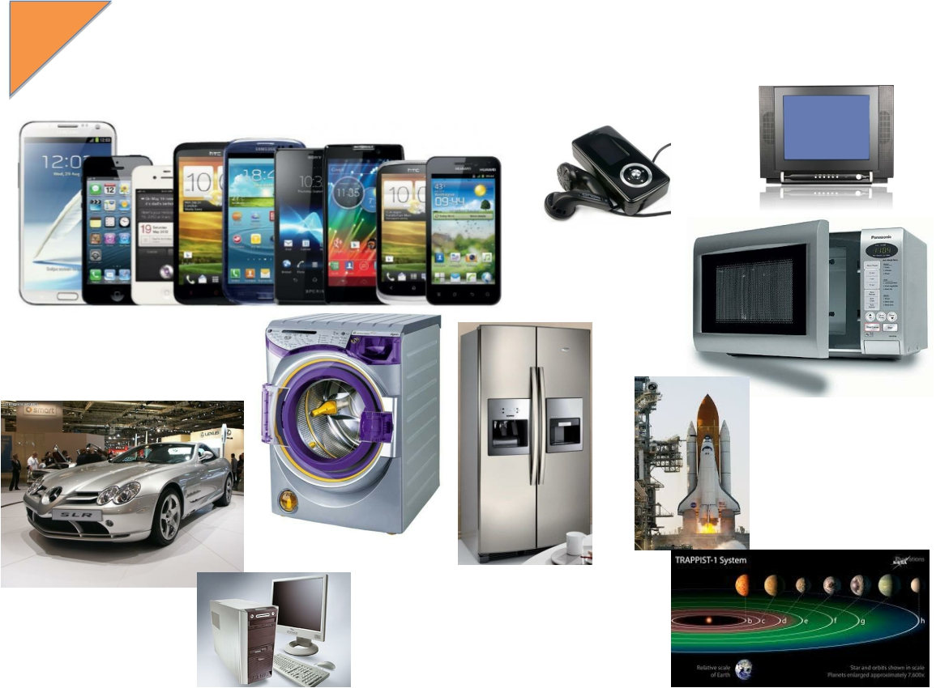
Microcontrollers rule!!!

Slide 17
Why is this important to your career?
Electrical engineers are involved in the design, development and manufacture of mobile phones, personal digital assistants, music players and personal computers. They also write system software and applications (apps) for all of these devices.
Did you know that there are an estimated 33.6million smartphones users in Malaysia in 2025
With demand increasing for smaller electronic devices with more and more functions, integrated circuit design is more complex and contains more components and mix components that would have previously been fabricated as separate devices.
Did you know that the first microprocessor, the Intel 4004, was introduced in 1971 and contained 2,300 transistors? Modern microprocessors contain several billion transistors. The history of the first microprocessor is worth reading
ECE3073 Computer Systems
clive.maynard@monash.edu
Notes:
I believe in studying the history of the technologies as well as the current needs!!! Putting things in context.

Slide 18
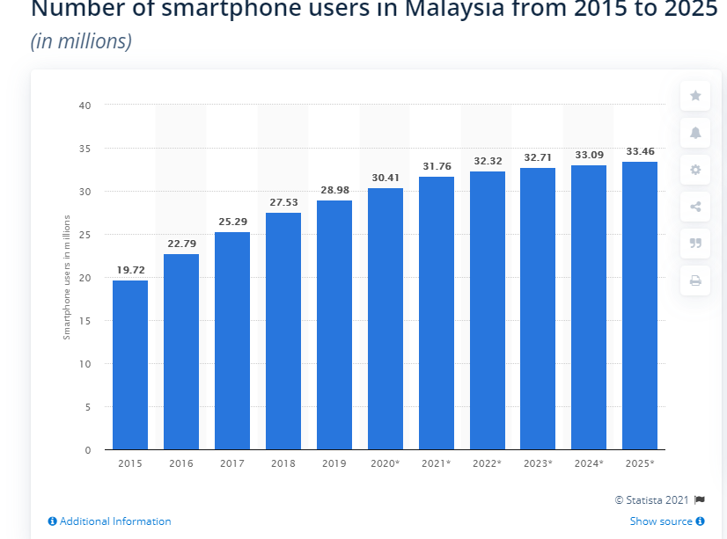
Contd..

Slide 19
Why is this important to your career?
You may be involved in the design of microprocessor-based systems for motorcars. These include engine management, airbag systems, active suspension, central locking, break by wire, climate control, entertainment and communications systems.
Did you know that by 2030 electronics will account for about 50% of the cost of a standard petrol driven motorcar?
Search for the article “This Car Runs on Code.”
Avionics is the term used to cover communications, navigation, engine management and display electronics in modern aircraft, all of it is microprocessor-based.
Fact: Avionics makes up about 18% of the cost of a transport aircraft. The proportion is much greater for military aircraft.
ECE3073 Computer Systems
clive.maynard@monash.edu

Slide 20
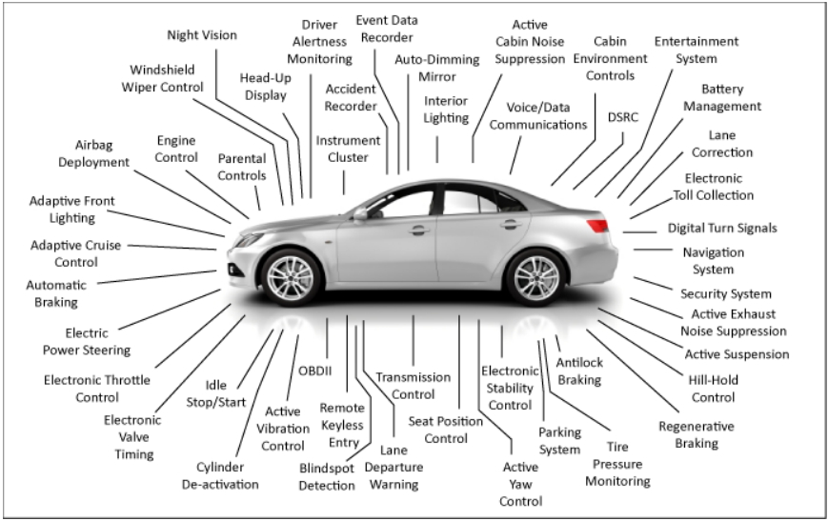
Electronics in a motor car
ECE3073 Computer
Systems
17

Slide 21
Computer Architecture
Computer architecture refers to the specification and interrelationship between the different components making up the computer. This is divided into two major parts, the hardware architecture (digital electronic components) and software architecture (program instructions that the computer executes).
Computer software and hardware architectures are very closely linked and inter-dependent.
In this unit we do not have time to look closely at the design considerations for either the hardware or software architecture.
However, we will point out some of the major issues.
ECE3073 Computer Systems
clive.maynard@monash.edu

Slide 22
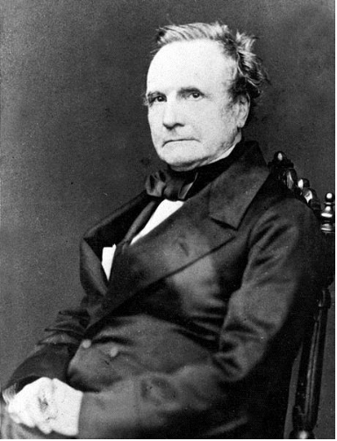
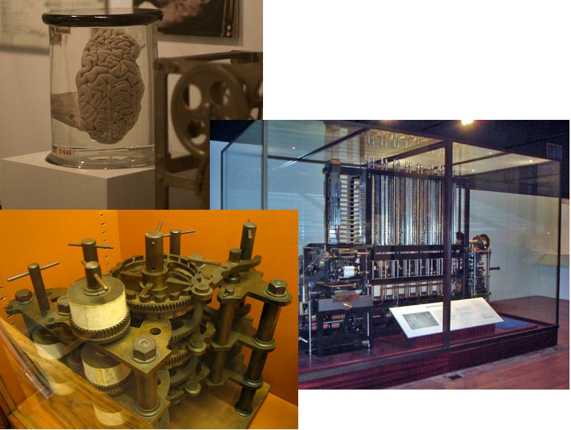
Some History
Charles Babbage
1820 – Mechanical computing machine
Thanks to wiki for pictures

Slide 23
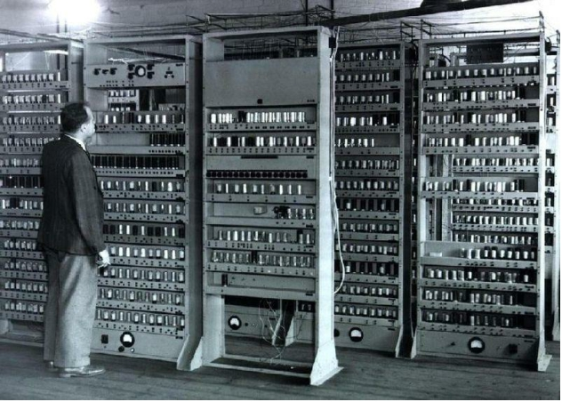
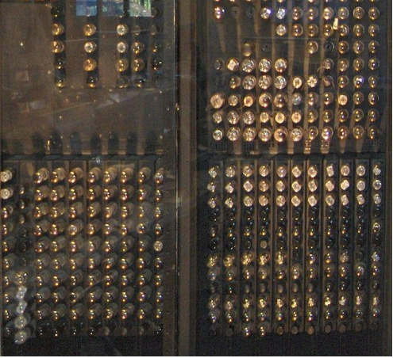
History
Electronic Delay Storage Automatic
Calculator (EDAC)1940
The 1946 Electronic Numerical
Integrator And Computer( ENIAC)
computer used 17,468 vacuum tubes and
consumed 150kW of power.

Slide 24
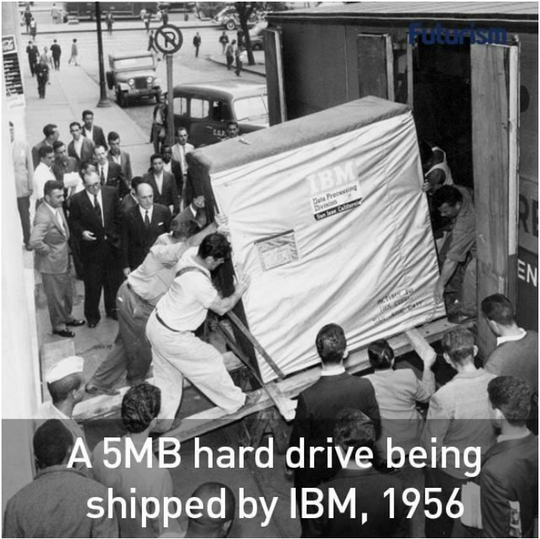
ECE3073 Computer
Systems
andy.russell@monash.edu
22

Slide 25
The Atlas Computer 1962-1971
Notes:
The Atlas Computer was one of the world's first supercomputers, in use from 1962 until 1971. It was considered to be the most powerful computer in the world at that time.[1] Atlas' capacity promoted the saying that when it went offline, half of the United Kingdom's computer capacity was lost.[2] It is notable for being the first machine with virtual memory (at that time referred to as 'one-level store') using paging techniques; this approach quickly spread, and is now ubiquitous.
Atlas was a second-generation computer, using discrete germanium transistors in place of vacuum tubes, which were used in earlier computers. Atlas was created in a joint development effort among the University of Manchester, Ferranti International plc and the Plessey Co., plc. Two other Atlas machines were built: one for British Petroleum and the University of London, and one for the Atlas Computer Laboratory at Chilton near Oxford.

Slide 26
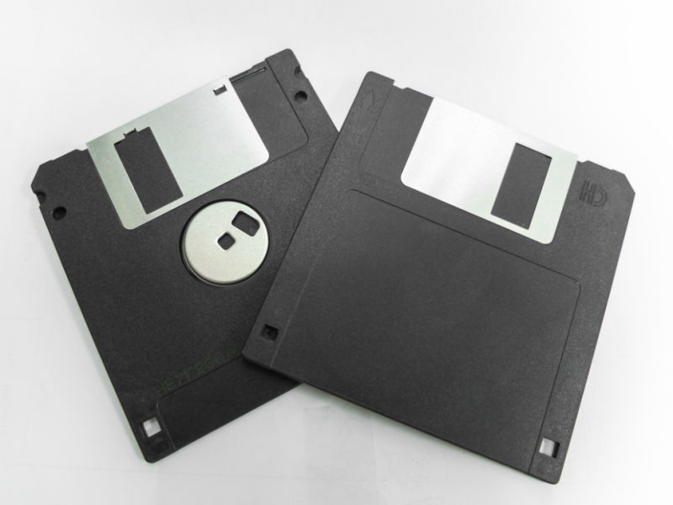
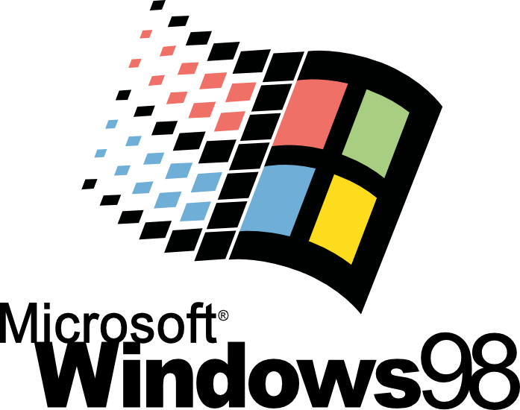
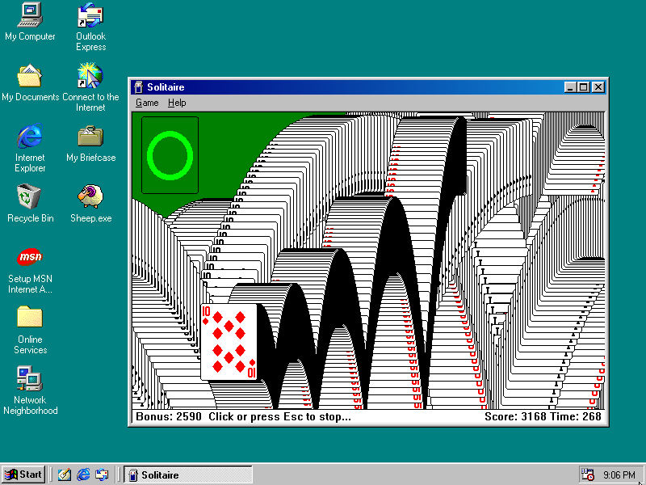
My memories ( back in 2001)
2001 – I was in Year 3 of Engineering

Slide 27
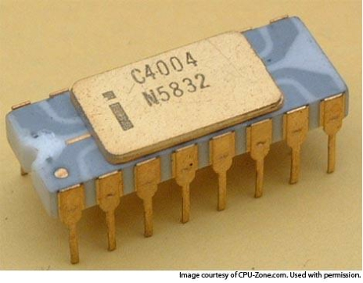
Early microprocessors
The 4004 was a tiny 4 - bit processor with
an 8 -bit wide instruction set . It was capable
of running at speeds up to 740 kHz and
could address up to 4 K of ROM and 1280 x
4 bits of RAM, although the accompanying
MCS- 4 chipset included a tiny 256 byte
mask - programmable ROM and 340 byte
RAM chip
Used in calculators
http://www.retrothing.com/2007/03/the_first_singl.html
Intel 4004 - 1971!!

Slide 28

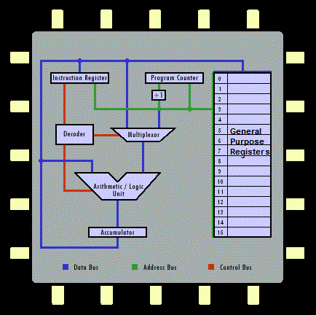
Registers

Slide 29
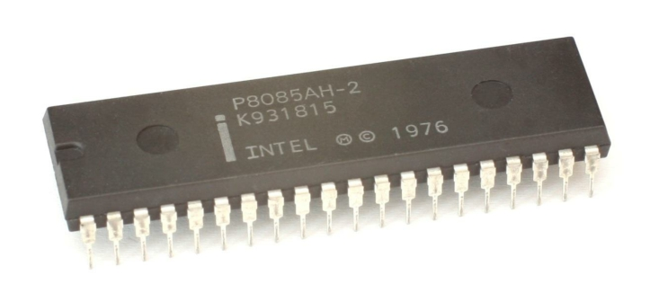
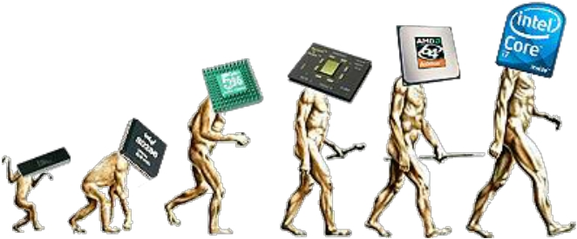
8085!!
Processor evolution
Introduced in 1976

Slide 30
A personal computer system

Slide 31
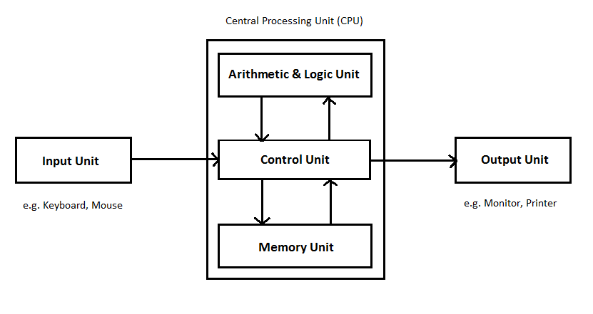
Computer Hardware Architecture
All digital computers contain the following major components:
• A control unit
• Instruction memory(part of memory unit))
• Data memory(part of memory unit))
• Input/output system/unit
• Data path (ALU and registers)
The hardware architecture of a computer depends upon how these components are implemented and interconnected.
A computer system contains all 5 of the above components.
A microcontroller contains all of the above components but will usually have memory and I/O circuits on the same chip.
A microprocessor usually contains a control unit and data path (memory and I/O systems are added externally). Modern microprocessors may also contain some memory.
ECE3073 Computer Systems
clive.maynard@monash.edu

Slide 32
von Neumann vs Harvard
Memory
CPU
Address
Data
Data
von Neumann
Program
PC
Used in EDSAC first American stored program computer
Memory
CPU
Address
Data
Data
Harvard
Address
Howard Aiken’s Mark III computer
Program
Instructions
PC
Modified Harvard architecture – single main memory but separate instruction and data caches
ECE3073 Computer Systems
clive.maynard@monash.edu

Slide 33
I/O Mapping
Memory Space
Memory Space
I/O access
I/O Space
I/O access
Memory-mapped I/O
Separate I/O space
For example the Infineon C167 I/O devices are addressed by:
mov r0, P3 ;read status bit from PORT 3
mov P7, #0001h ;write a 1 to PORT 7 bit 0
;note that P3 and P7 are addresses in memory space
For example the 8086 I/O space is addressed by:
IN AL, 7 ; get status of stepper-motor
OUT 7, AL ; turn off 3rd magnet of the
; stepper-motor.
ECE3073 Computer Systems
clive.maynard@monash.edu

Slide 34
A microprocessor (6800)
The instruction set must match the programming model to create the Software Architecture

Slide 35
Computer Software Architecture
CISC – Complex Instruction Set Computing
Early computers were programmed in machine code and later assembler. To make this task easier for a human programmer computer designers created powerful, easy to use instructions. CISC computers supported 100’s and later 1000’s of complex instructions. Inevitably this required complex, relatively slow computer hardware.
Advantages:
provides a wide range of powerful instructions
relatively easy for a human programmer
Disadvantages:
Hardware to support the instruction set is complex and slow
difficult to write a compiler to make efficient use of the instruction set
ECE3073 Computer Systems
clive.maynard@monash.edu

Slide 36
Computer Software Architecture
RISC – Reduced Instruction Set Computing
With the introduction of higher level languages such as C, Pascal, Ada, etc. the task of generating assembler/machine code fell to the compiler. It proved difficult/impossible to get the compiler to use more than a small subset of the available instructions. It became evident that complex operations tended to be slower than a sequence of simpler operations doing the same thing. This lead to the development of simple, fast computers with many registers and few instructions – RISC architecture computers.
Advantages:
relatively easy for a compiler to produce efficient code using a simple instruction set
computer hardware is simple and runs fast
Disadvantages:
Program size is longer (takes more instructions to perform the same task)
more difficult for a human to code
ECE3073 Computer Systems
clive.maynard@monash.edu

Slide 37
Next
The Nios processor is a ‘soft’ processor defined in a hardware description language (Verilog in our case) that can be downloaded and run on an Altera FPGA. An advantage of this system, as opposed to a microprocessor system based on a hardware microcontroller is that peripherals can be designed (or you can used predesigned peripherals) and added to the system without making alterations to the system hardware.
In the next group of slides we will look at the parts of a Nios processor system that you will have access to as a programmer and the machine code/assembler instructions that you can use to write a program.
ECE3073 Computer Systems
clive.maynard@monash.edu

